Slide 1







www.read-lab.eu
ReadLab
WHO WE ARE

Slide 2





Research Innovation and Development Lab
About
Research Innovation and Development Lab - ReadLab is a Greece-based research institution dedicated to fostering positive social and sustainable impact through innovation. Since its establishment in 2017, ReadLab has been at the forefront of delivering high-quality research, training, educational, consulting, and ICT services across local, national, European, and international levels.
52
8
11
www.read-lab.eu
Contact Info
Head Office
Pyli, Trikala 42032
Thessaly, Greece
Registered office
233 – 235, Imittou Str
11632 Athens, Greece
+30 21 1111 2341
team@read-lab.eu

Slide 3



Vision & Impact
ReadLab has achieved in just a few years to reach and expand its work and impact in the European Union, the Balkans, Northern Africa and Asia and the Pacific
ReadLab is a member of the ALL DIGITAL network and the SexSense-Institute of Comprehensive Sexuality Education Network.
THINK GLOBAL
ACT LOCAL
BE INTERNATIONAL
Think global, act local and vice versa:
Our International Outreach

Slide 4

Areas of Activity
ReadLab operates in the following sectors by offering high-quality multidisciplinary expertise
1
INNOVATION - ICT - EdTech
ReadLab provides Information and Communication Technology (ICT) services, specialising in tailor-made technological solutions and software tools. This includes the creation of custom e-Learning platforms, interactive digital learning content, Augmented, Virtual and Mixed Reality (AR/VR/MR) applications designed for educational purposes, engaging learning games, and sophisticated visualisation tools
2
TECHNICAL ASSISTANCE
ReadLab offers tailored advice and assistance to public and private institutions, helping them transform and innovate across a wide range of areas. This involves sharing expertise, training and capacity building, technology implementation, research, policy development, quality assurance, impact assessment, and evaluation.
3
RESEARCH- QA-EVALUATION
List of Activity
ReadLab designs and delivers primary data research and data analysis for both qualitative and quantitative data, using a variety of methodologies and tools customised to end-user needs. ReadLab leverages grant-based funding to conduct impactful research, quality assurance and evaluation to advance scientific knowledge and address real-world challenges.
4
EDUCATION/TRAINING
ReadLab works with institutions of all levels and types to develop strategies, business plans and projects to enhance the education and training sector. Additionally, ReadLab designs and delivers customised training seminars for EU and international institutions, private companies, and individual learners including professionals, teachers, adults, youth and disadvantaged persons.

Slide 5






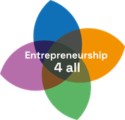













Our Project Numbers at a glance
TOTAL EU PROJECTS
ONGOING EU PROJECTS
SERVICES
71
33
For more information about our projects you can always visit:
www.read-lab.eu/our-work/projects/

Slide 6

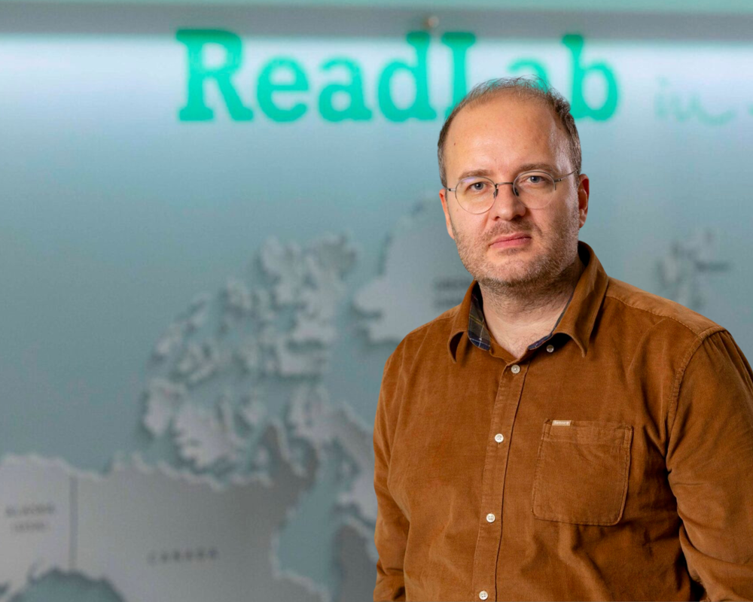
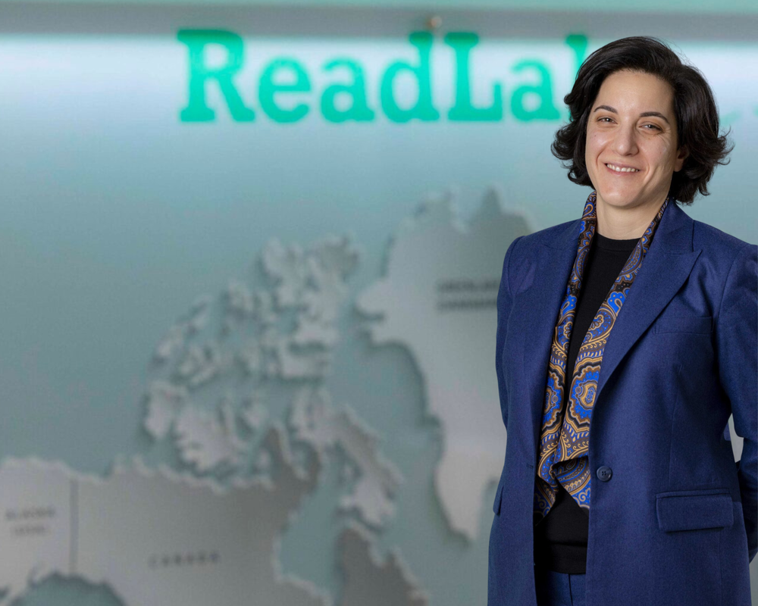
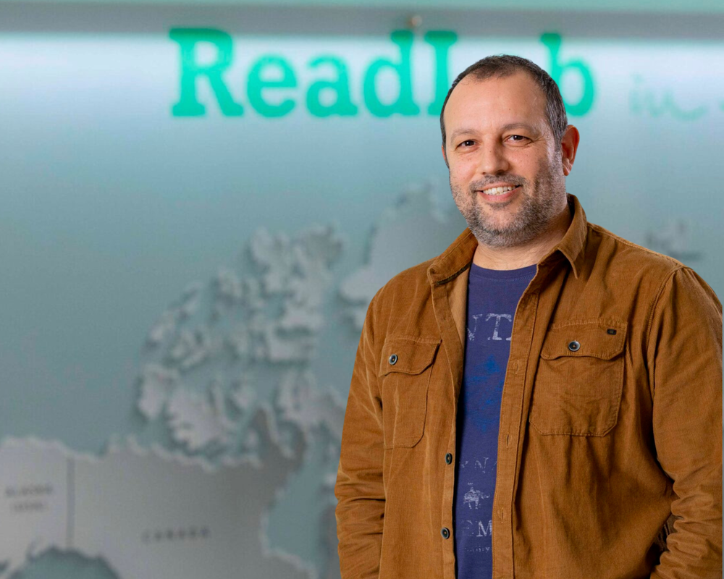
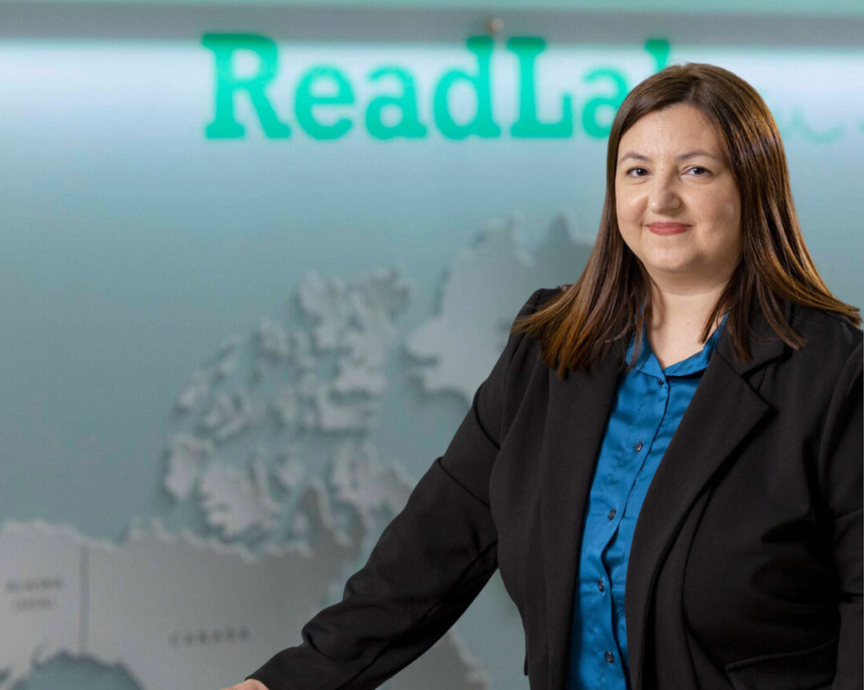
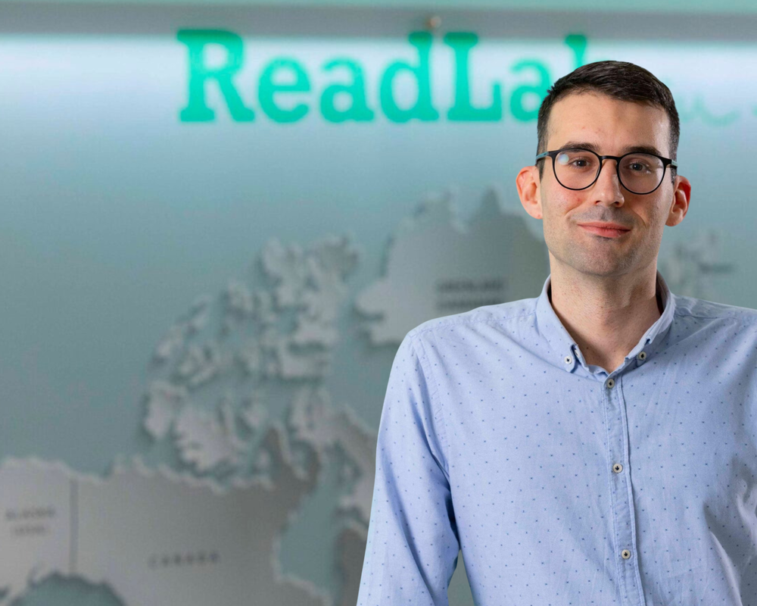
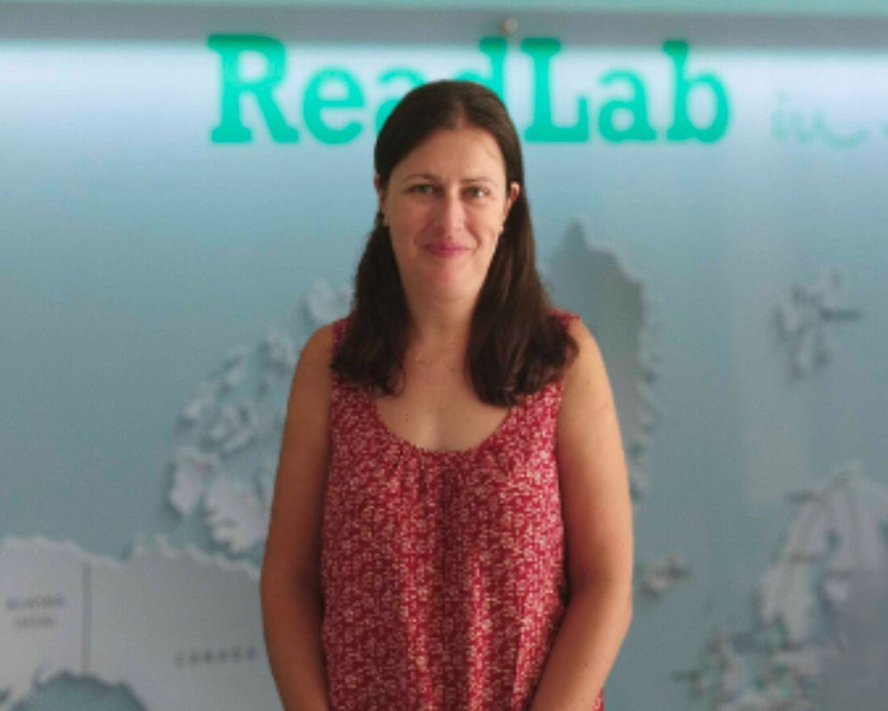
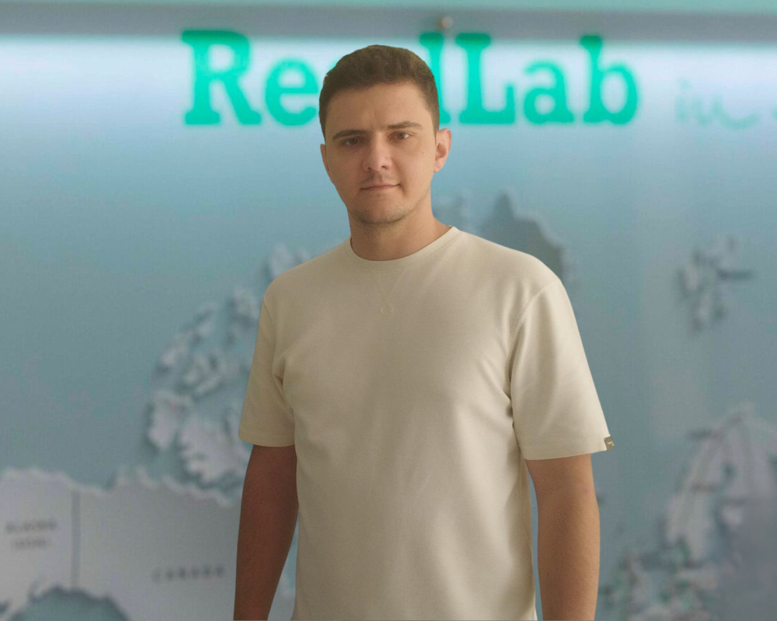
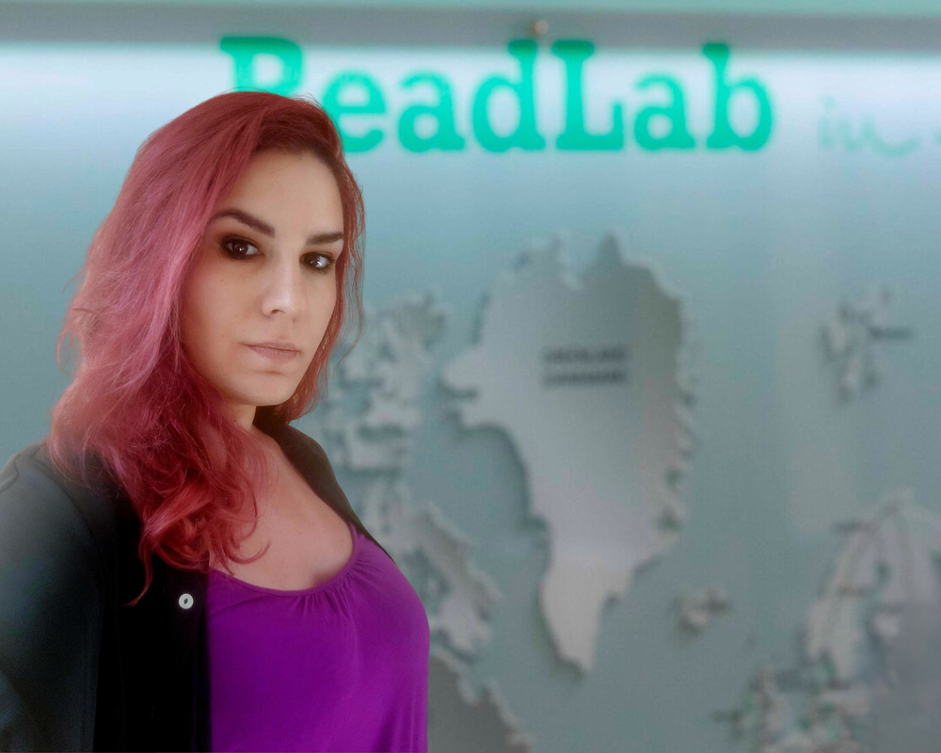
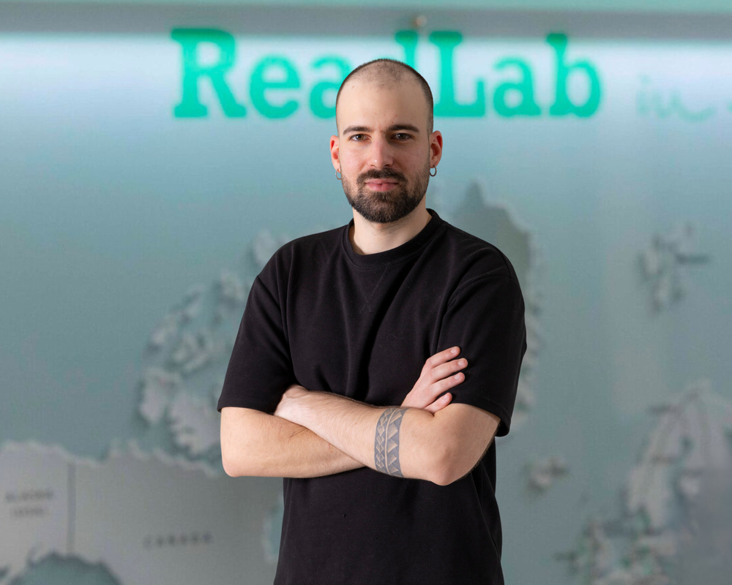
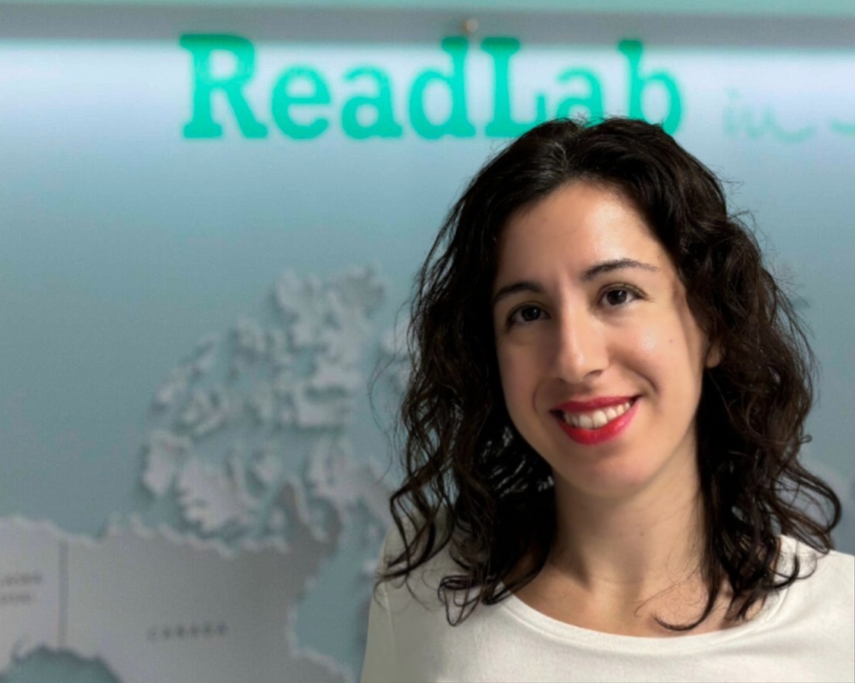
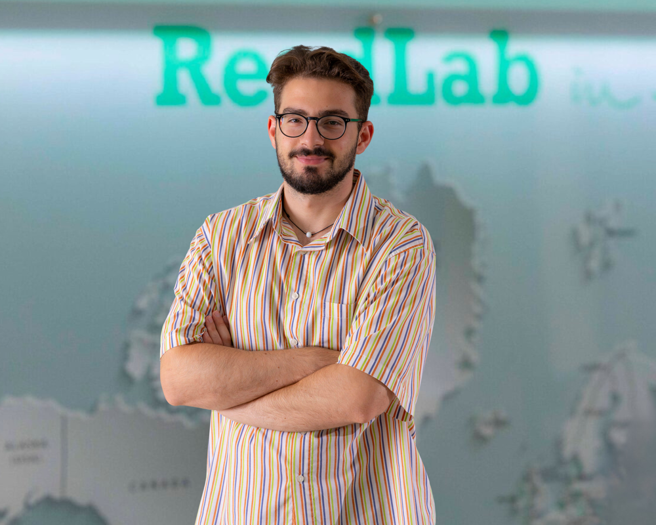
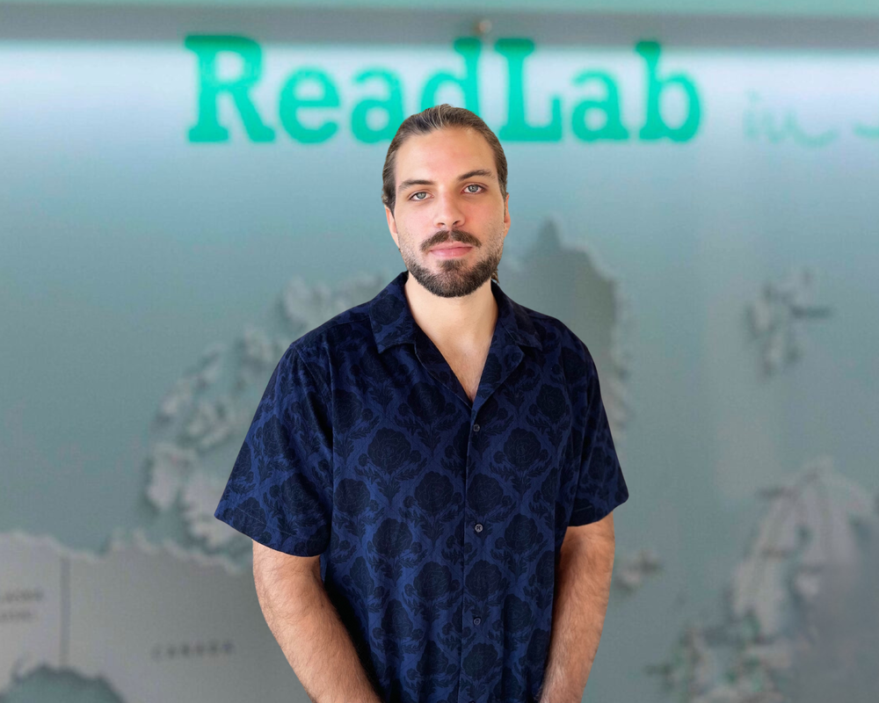
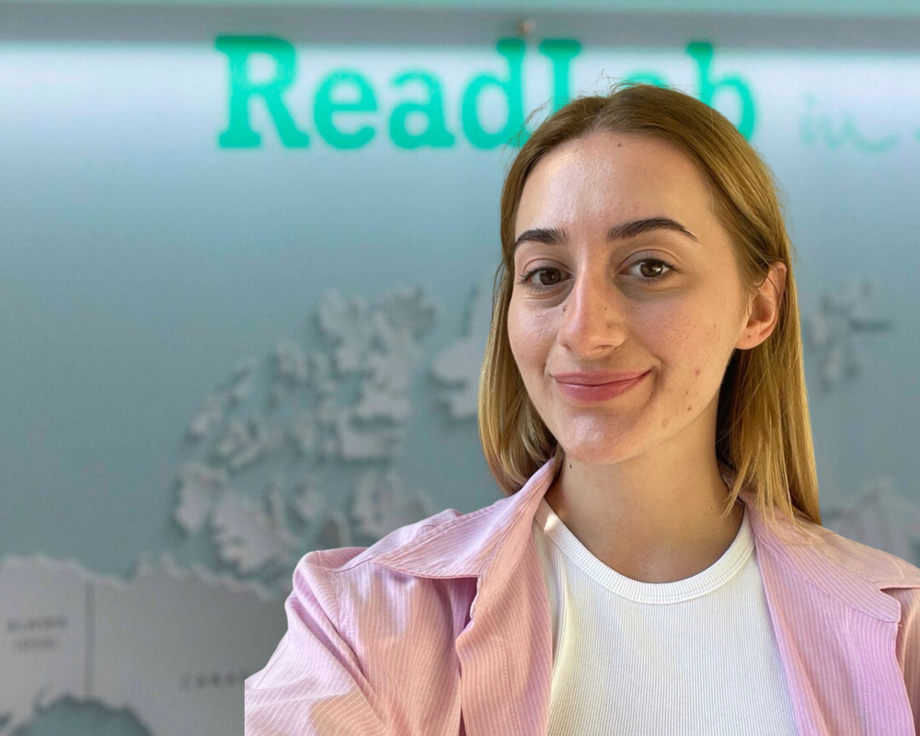
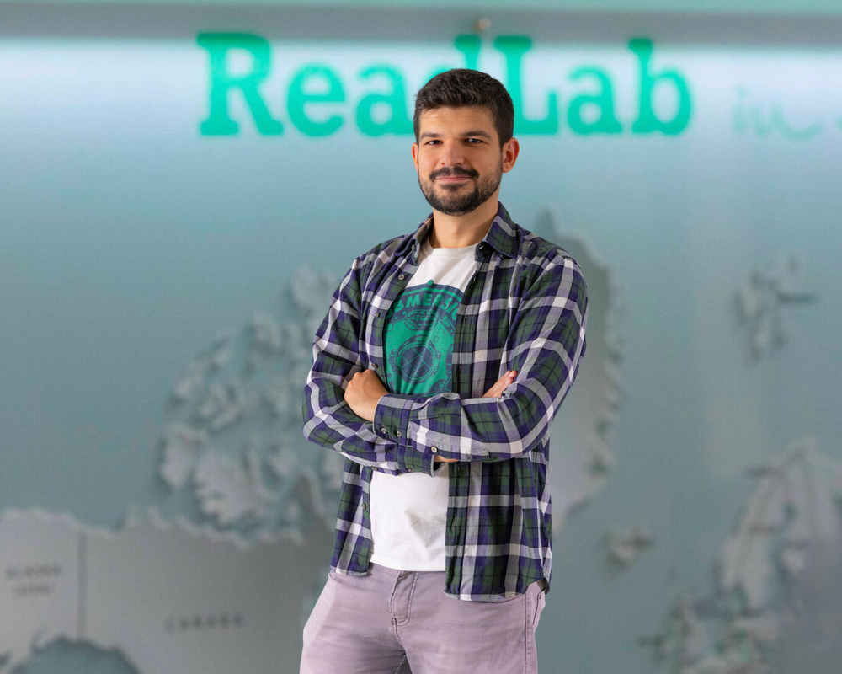
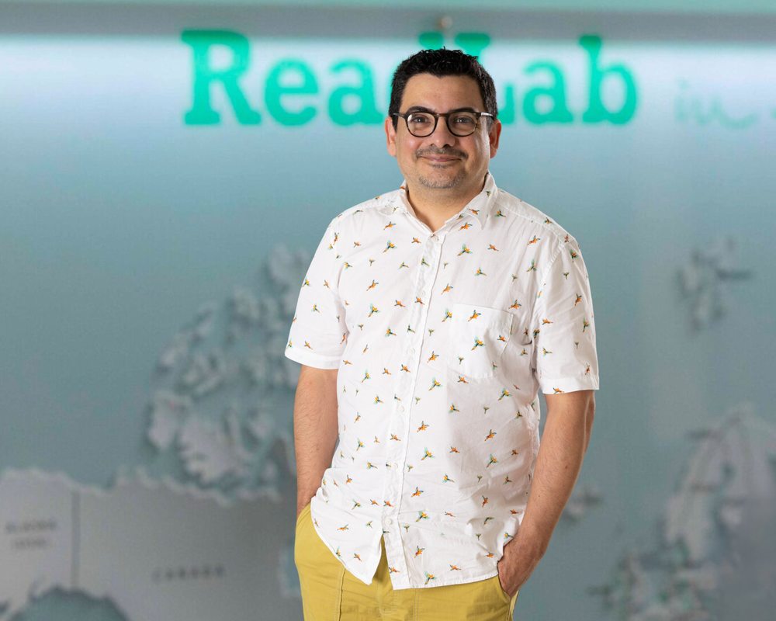
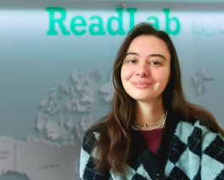
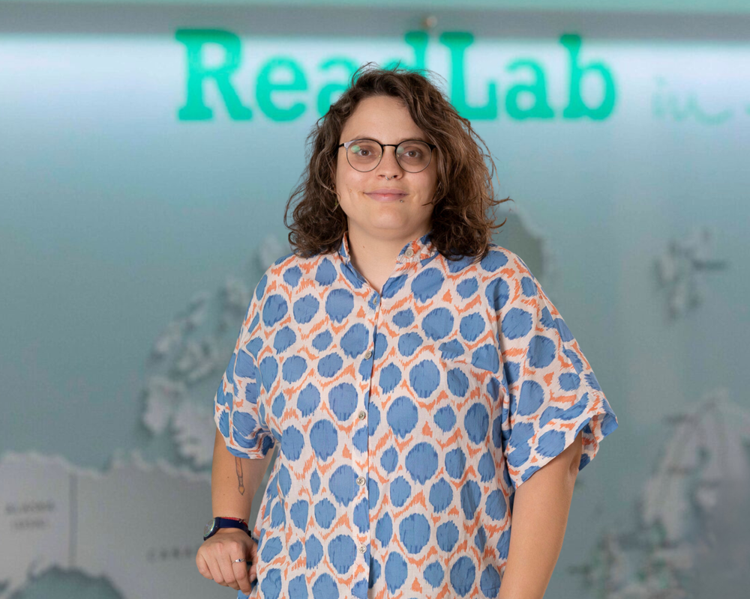
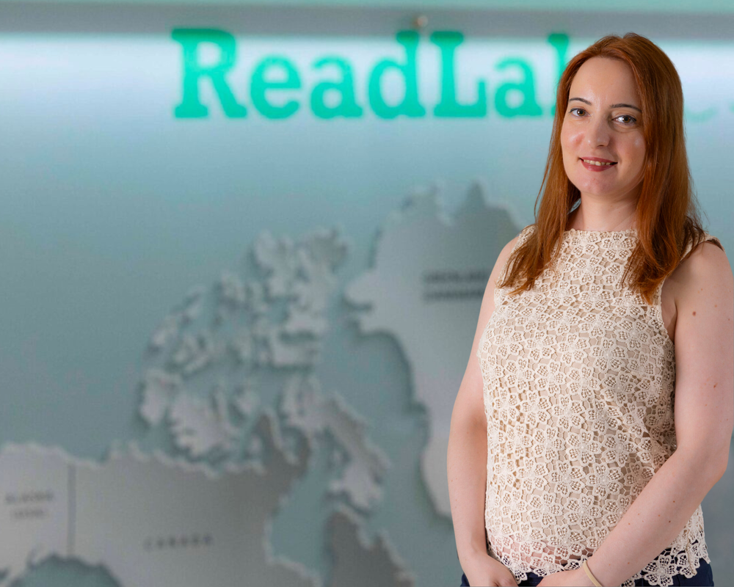
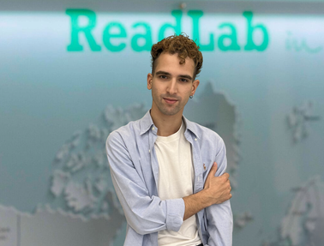

Meet Our Stellar Team
At ReadLab, we're not just a team! We're a driving force for innovation and transformation in the business world.
Stefanos Vagenas
Co-Founder & CEO
Vassiliki Chatzipetrou
Co-Founder & CEO
Petros Chondros
Technical Business
Development Manager
Nikoletta Migka
Financial Manager
Pantelis Kouvelis
Lead Project Manager
Maria Papageorgaki
Technical Manager
Stergios Nakas
Financial Officer
Lydia Vakoula
Project Manager
Dimitris Pirpiris
Software Engineer
Olga Karamichailidou
Project & Development Manager
Odysseas Vlachonikolos
Project Officer
Panagiotis Argyropoulos
Software Engineer
Team’s Profile
Keida Mihai
Project Officer
Kostas Kazantzidis
Project & Development Manager
Luis Torres
Instructional Designer
& eLearning Developer
Stefania Vasilaki
Project Officer and Researcher
Avra Sotiropoulou
Graphic Designer
& Communication Officer
Orestis Panagiotakopoulos
Project Officer
Konstantina Kaoudi
Operations & Admin Officer

Slide 7


Pantelis Kouvelis
Lead Project Manager
pantelis@read-lab.eu

